Slide 1
Preliminary Research and Data Gathering
For Audio Anomaly Detection Demo
07/20/20

Slide 2
Preliminary Research
Audio Surveillance of Roads: A System for Detecting Anomalous Sounds
IEEE Transactions On Intelligent Transportation Systems
2016

Slide 3
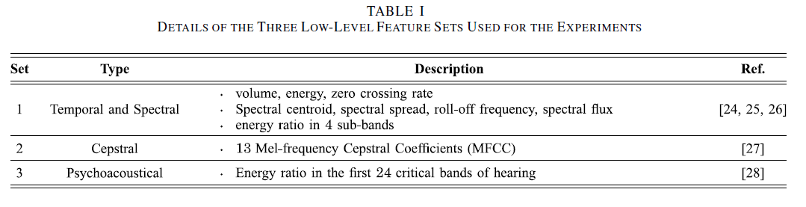
Preliminary Research
Two-level representation of audio stream

Slide 4
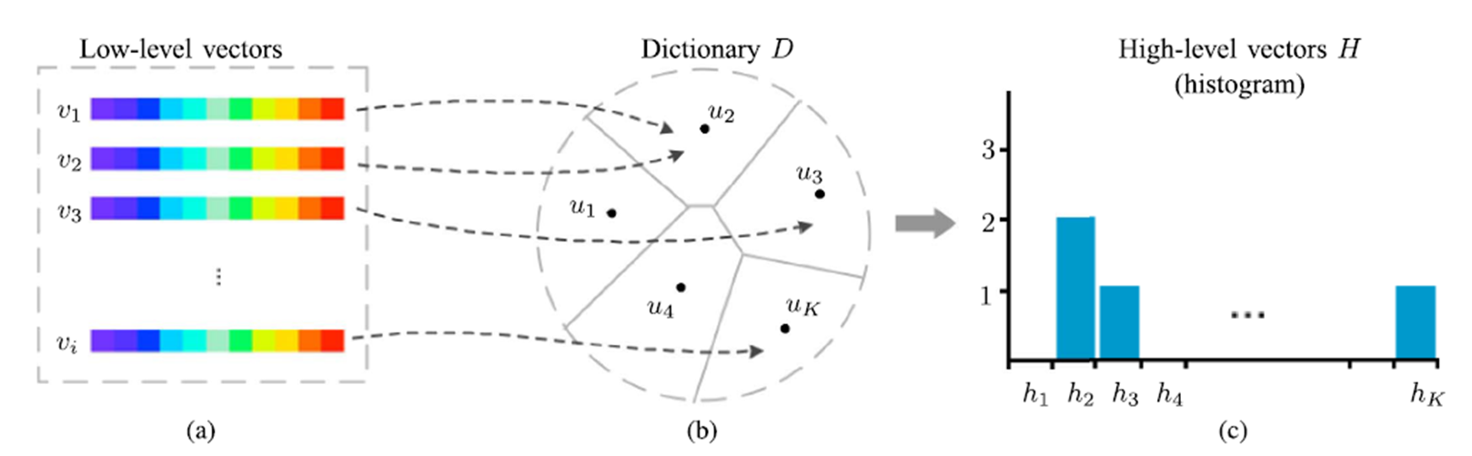
Preliminary Research
Two-level representation of audio stream

Slide 5
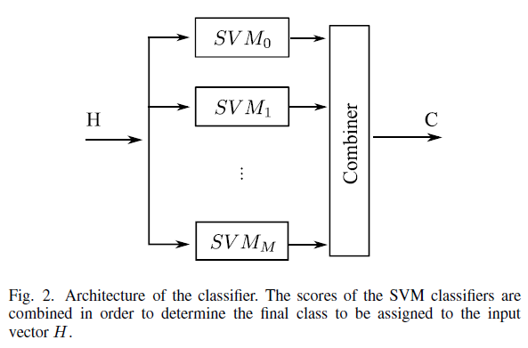
Preliminary Research

Slide 6


Preliminary Research

Slide 7
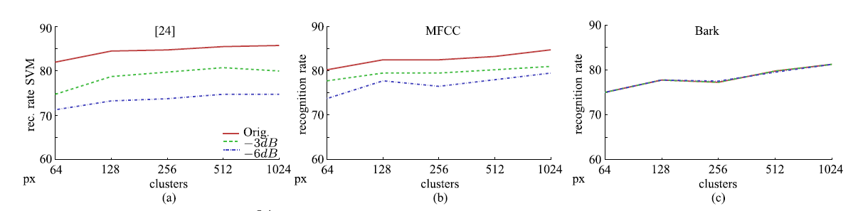
Preliminary Research

Slide 8
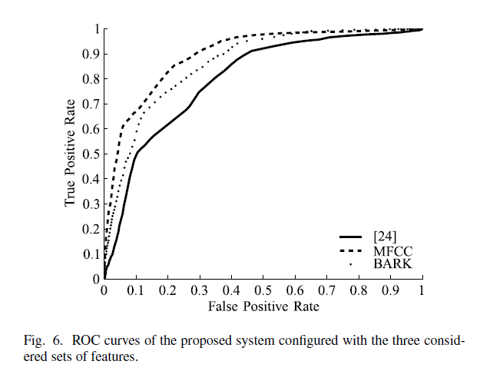
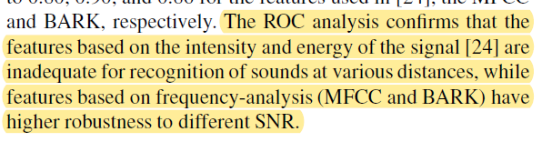
Preliminary Research

Slide 9
Preliminary Research
Car Accident Detection and Recognition Through Sound Analysis with Crashzam
International Conference on Vehicle Technology and Intelligent Transport Systems
2018

Slide 10
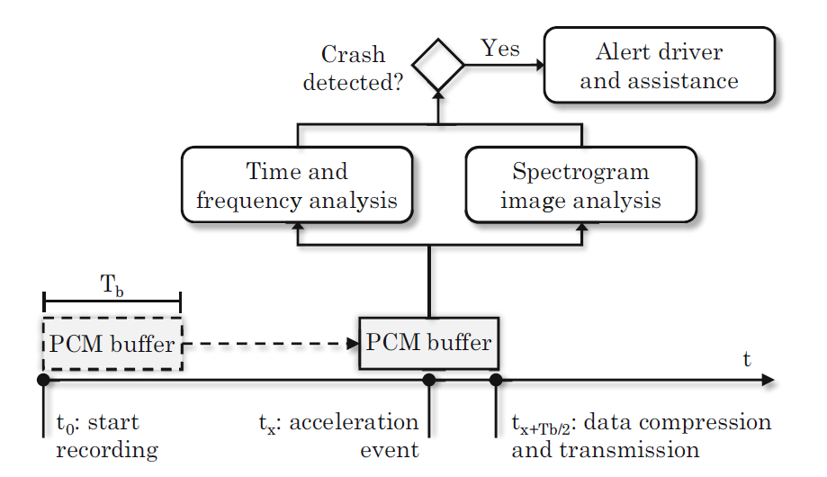
Preliminary Research

Slide 11
Preliminary Research
Time Domain Features
Zero Cross Rate
Signal Power
Entropy
Frequency Domain Features
Spectral Centroid
Spectral Spread
Spectral Flux
Spectral Rolloff
Spectral Entropy
Chroma Vector
Mel-Frequency Cepstral Coefficients (MFCCs)

Slide 12
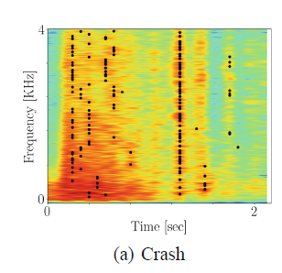
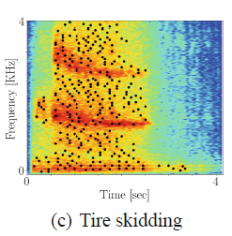
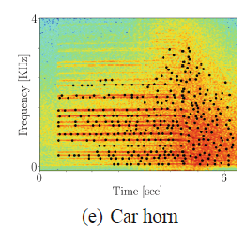
Preliminary Research
Spectrogram Image Analysis
Peak Vertical Alignment
Peak Horizontal Alignment
Peak Entropy

Slide 13
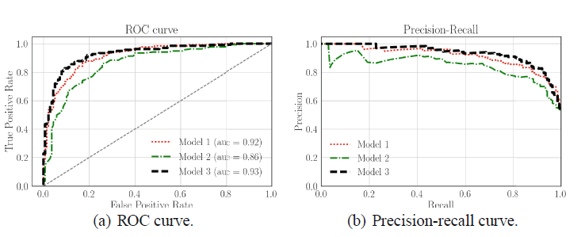
Preliminary Research
Random Forest Classifiers

Slide 14
Preliminary Research
Detection of Hazardous Road Events From Audio Streams: An Ensemble Outlier Detection Approach
IEEE Conference on Evolving and Adaptive Intelligent Systems
2020

Slide 15
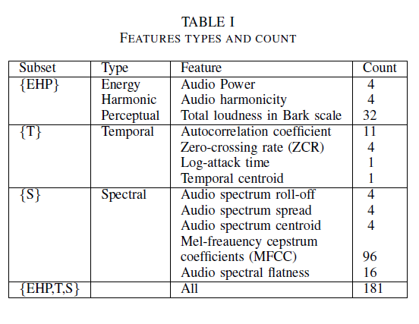
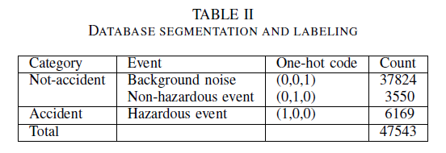
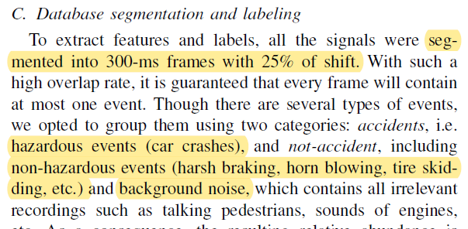
Preliminary Research

Slide 16
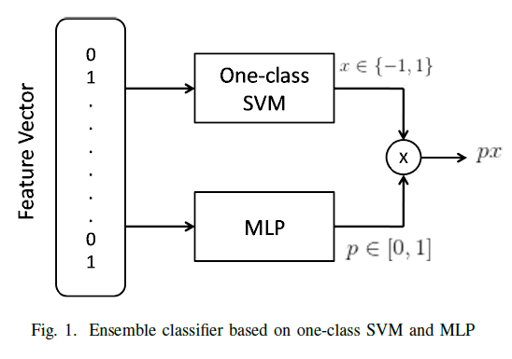
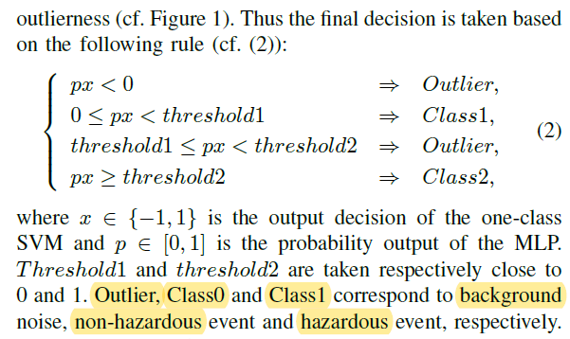
Preliminary Research

Slide 17
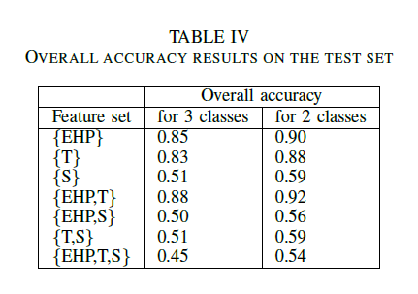
Preliminary Research

Slide 18
Data Gathering
Labeled Audio Dataset
DCASE – Detection and Classification of Acoustic Scenes and Events
AudioSet > Vehicle > Motor Vehicle (Road)
MIVIA Road Audio Events
Urban Acoustic Environment > Mechanical > Motorized Transport > Road

Slide 19
Data Gathering
Unlabeled Audio Dataset
Car Crashes Time Youtube

